Slide 1
Visual Studio
Microsoft Visual Studio is an Integrated Development Environment (IDE) from Microsoft.
It is Used to Develop Websites, Web Services and Mobile Applications.
Programming Languages: C#, C++, Visual Basic, Visual Basic.NET, J#.

Slide 2
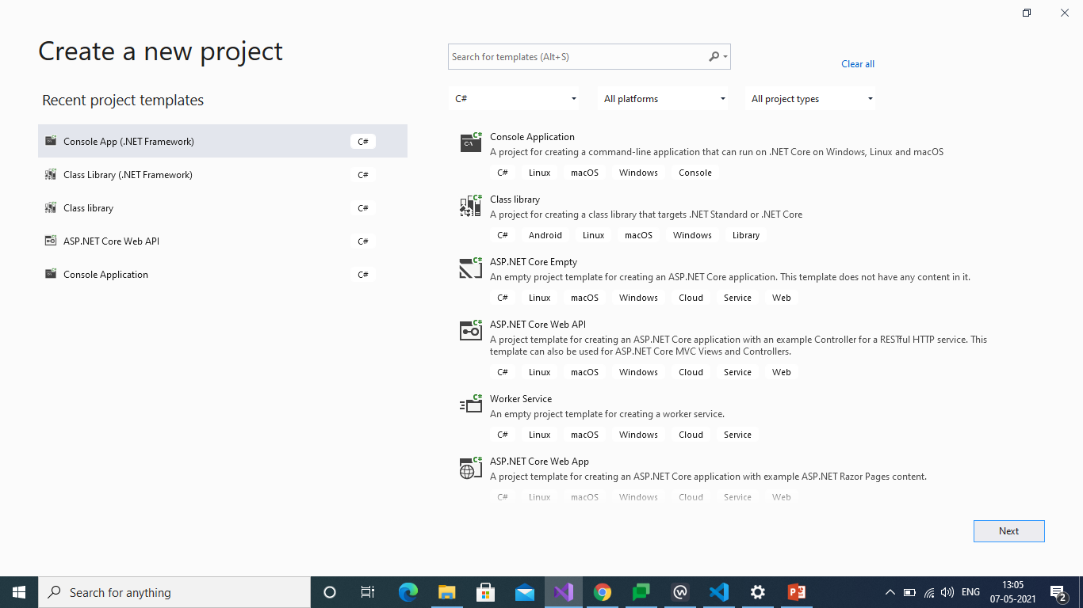
How Create a New Project

Slide 3
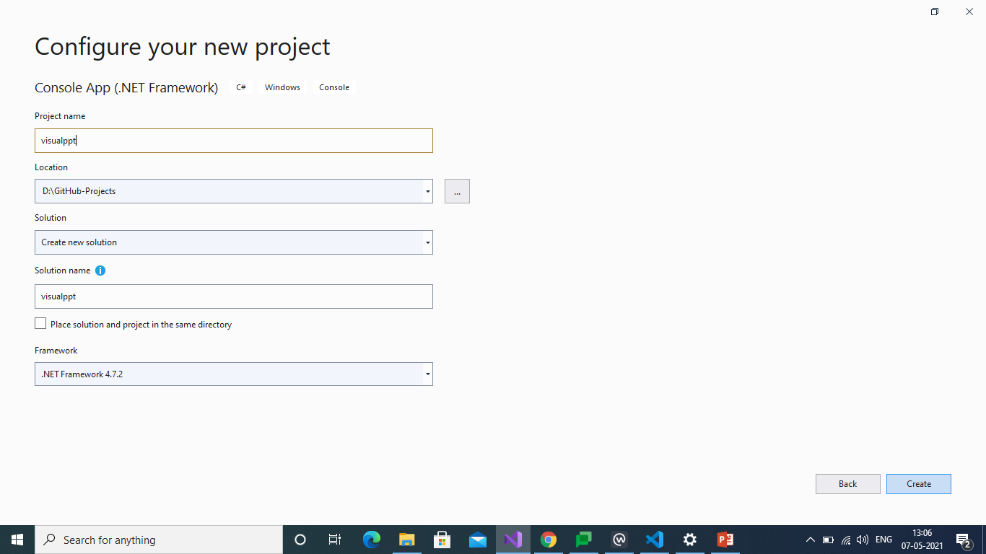
How to Configure That Project

Slide 4
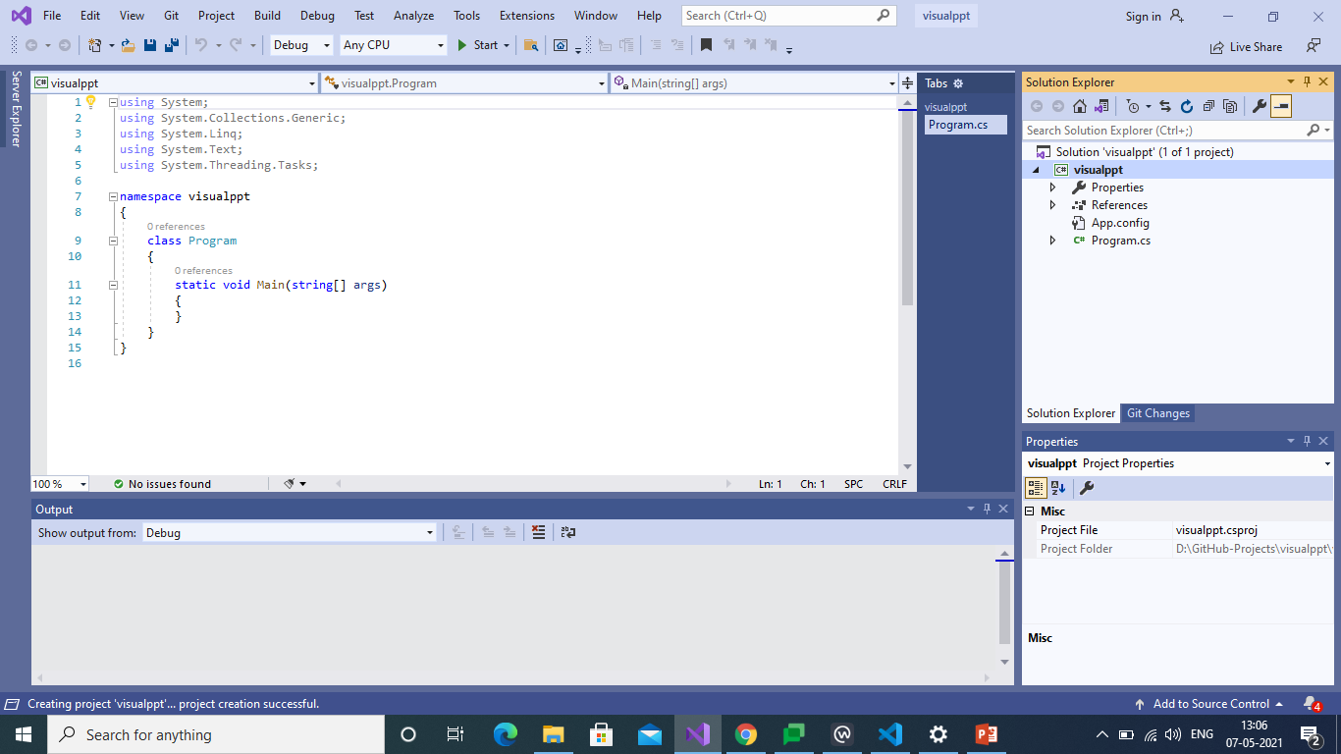
Project will be Appeared Basic Structure

Slide 5
Visual Studio Code
Visual Studio Code is a Freeware Source-code Editor made by Microsoft for Windows, Linux and mac OS.
It is Supported for Debugging and Syntax Highlighting.
And it has Intelligent Code Compiler.
It is Easy to Use.
It Contains Friendly Environment with understandable features.

Slide 6
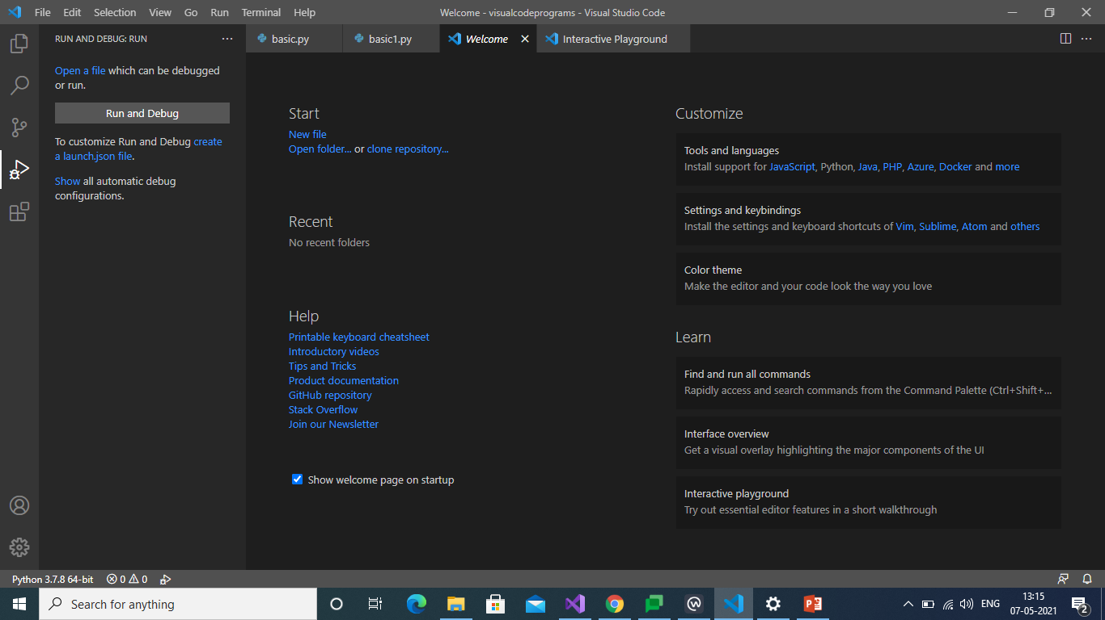
Welcome Page

Slide 7
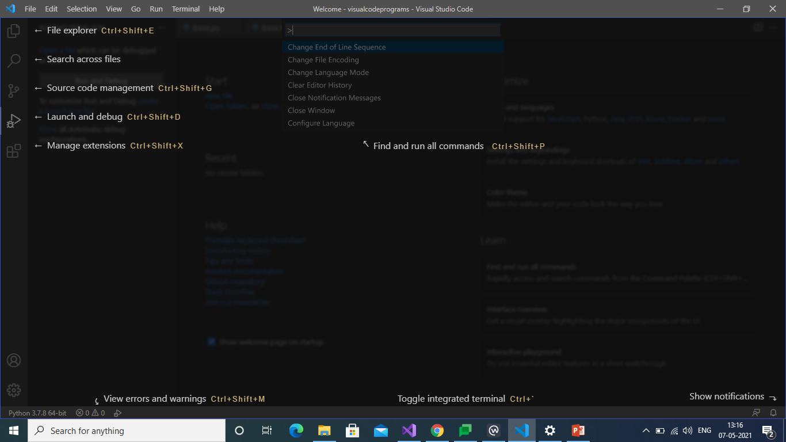
Interface Overview

Slide 8
GITHUB
GitHub is a code hosting platform for version control and collaboration.
It lets you and others work together on projects from anywhere.
GitHub contains essentials like repositories, commits, and Pull Requests.
Team members can work on files and easily merge their changes.

Slide 9
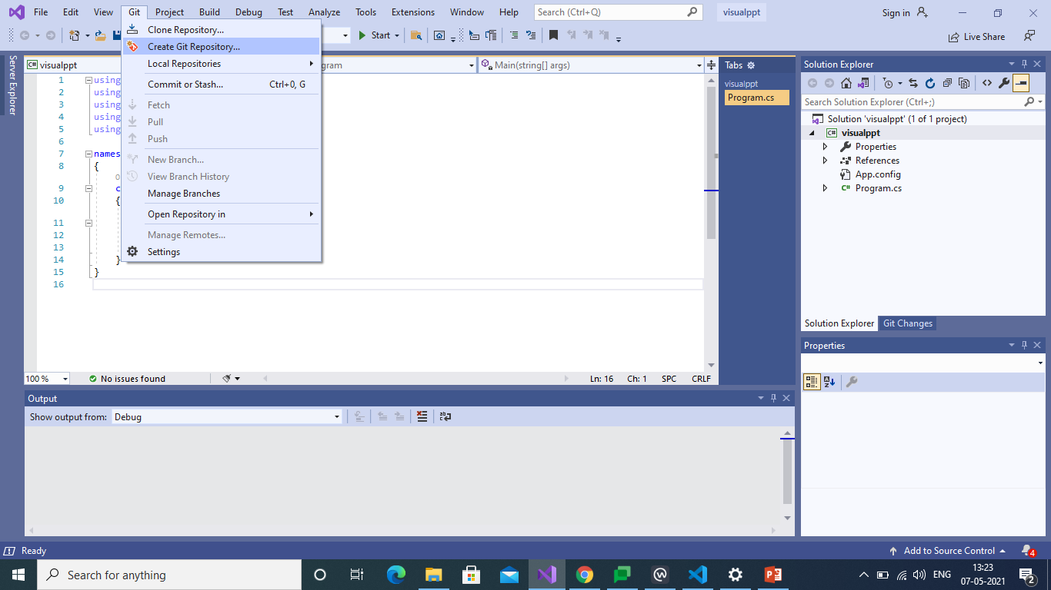
Connection Repositories

Slide 10
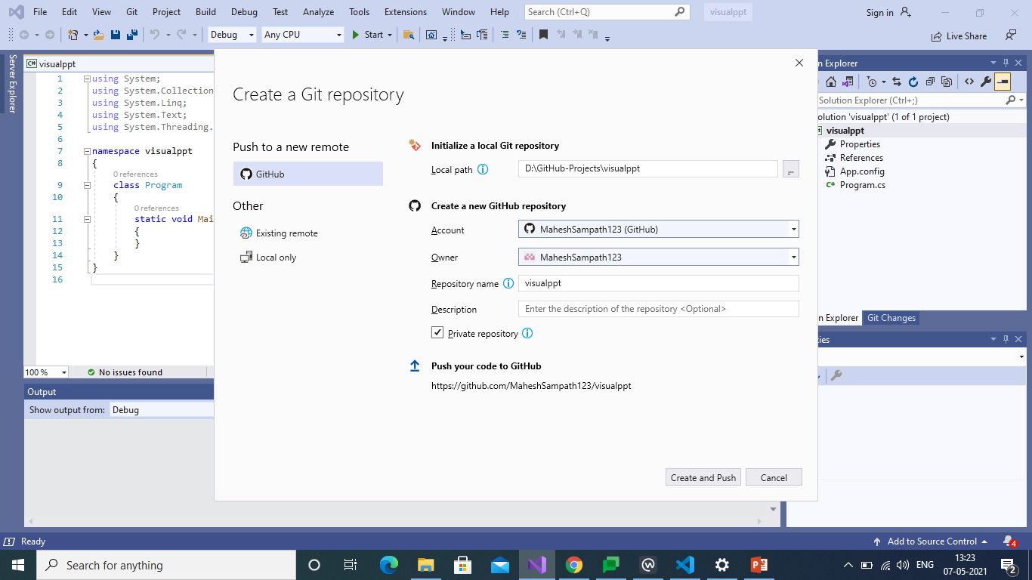
It will show the Repository Path

Slide 11
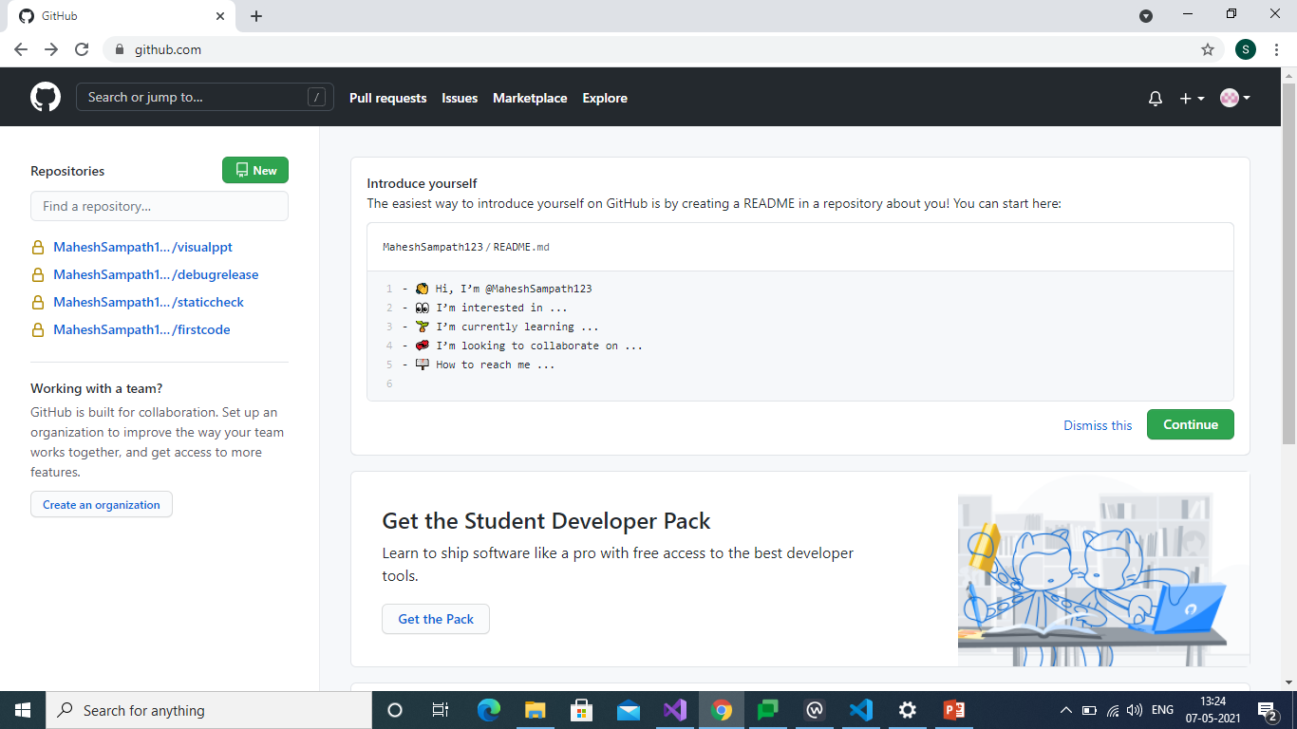
After Creation We Can See Repository

Slide 12
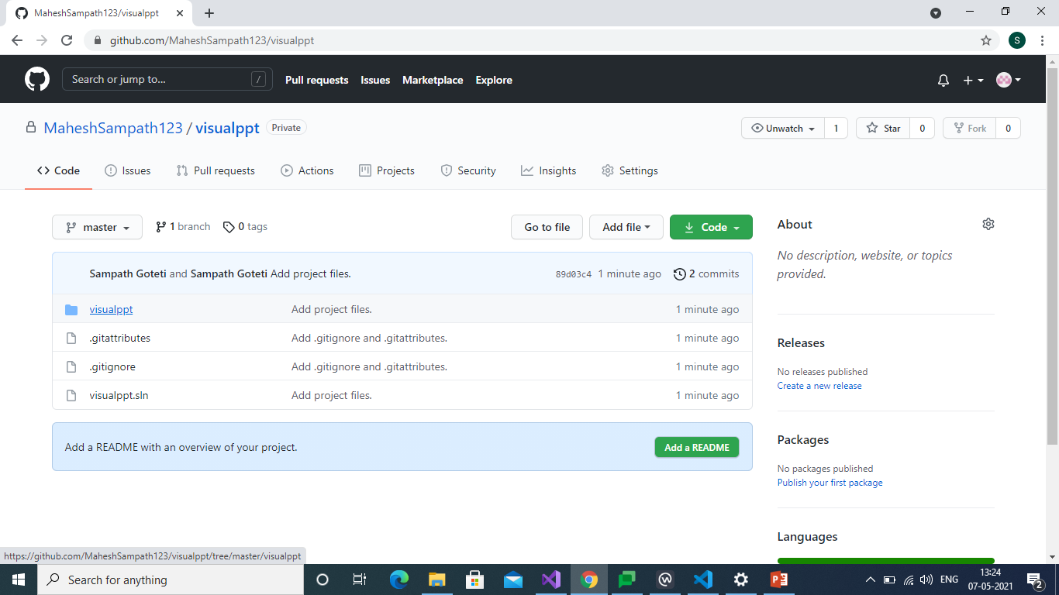
Files in our Repository

Slide 13
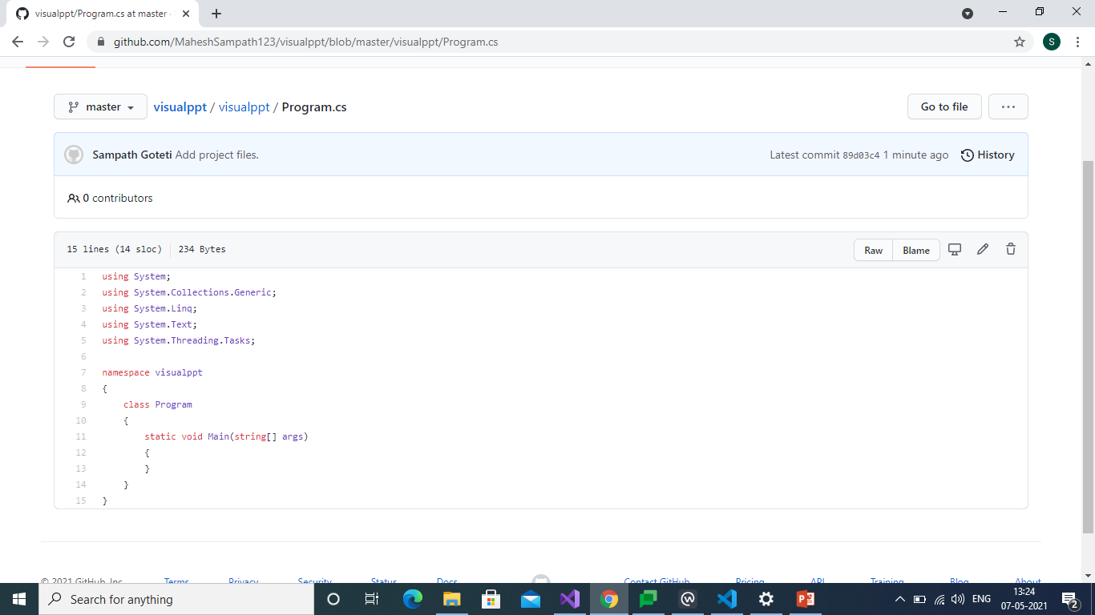
Finally We can see our Code

Slide 14
BITBUCKET
Bitbucket is our Git repository management solution designed for professional teams.
It gives you a central place to manage git repositories, collaborate on your source code and guide you through the development flow.
Pull requests with in-line commenting for collaboration on code review.

Slide 15
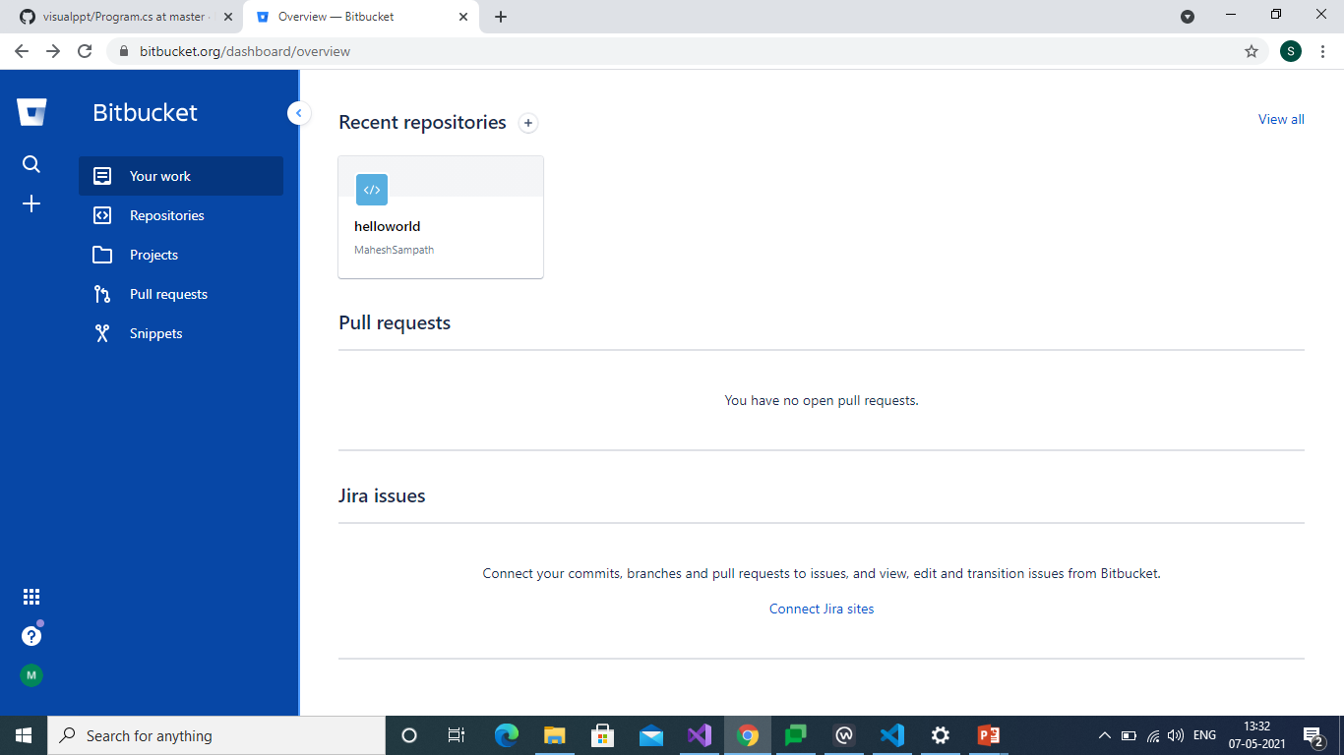
First Page

Slide 16
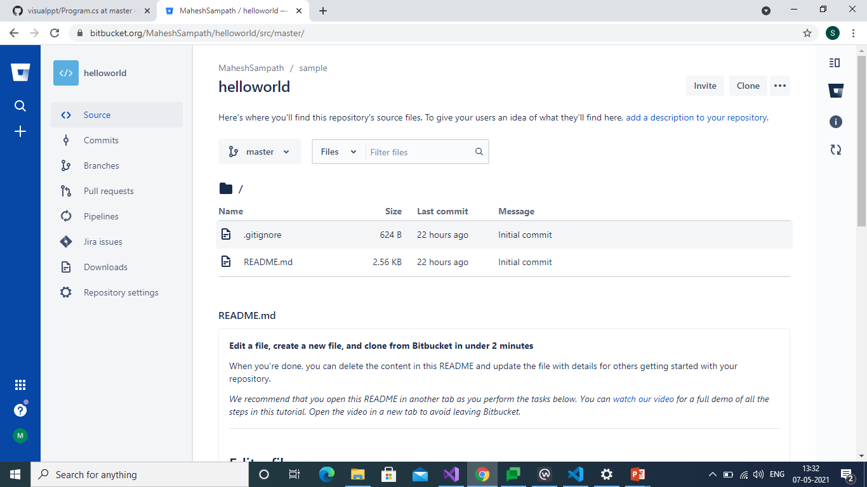
We can Create Repository

Slide 17
GIT
Git is a free and open source distributed version control system designed to handle everything from small to very large projects with speed and efficiency.
Git is easy to learn and has a tiny footprint with lightning fast performance.

Slide 18
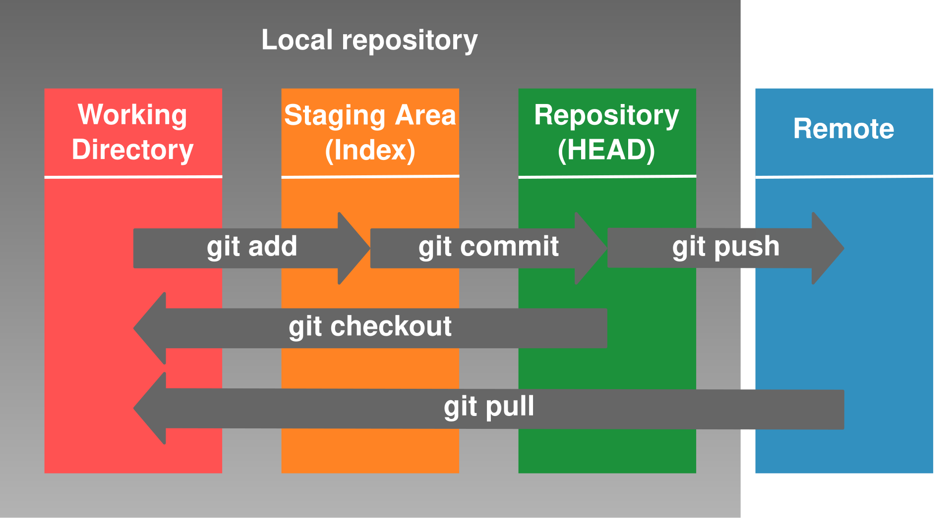
Process

Slide 19
Stages
There are Three Stages of a file in a Repository namely Untracked, Staged and Committed.
UNTRACKED: The file exists, but is not part of Git’s version control.
STAGED: The file has been added to Git’s version control but changes have not been committed.
COMMITTED: The change has been Committed.
Git Status: To check that in which state the files and folders are.

Slide 20
GIT Connection For GITHUB

Slide 21
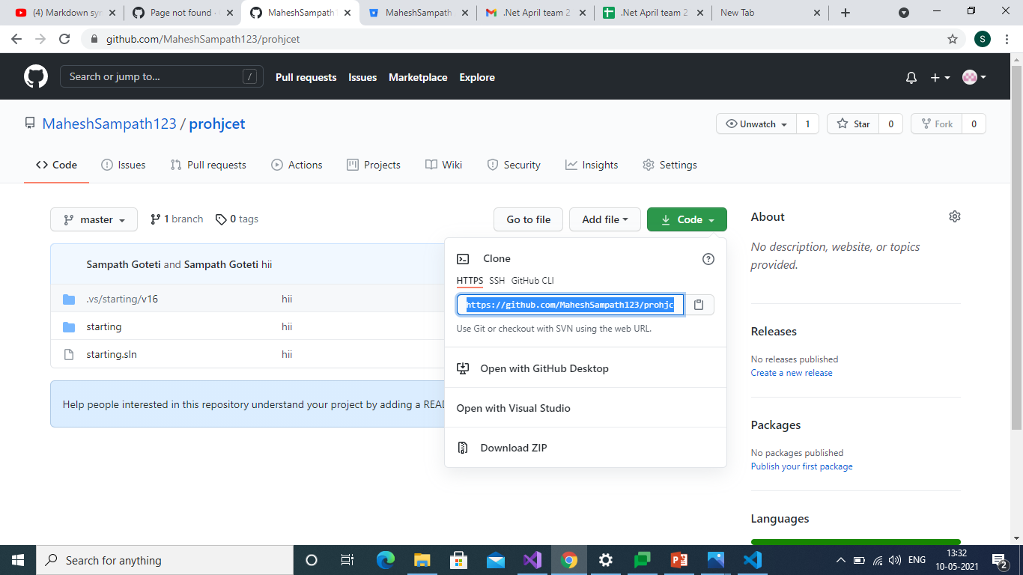
Repository clone Area to Store file

Slide 22
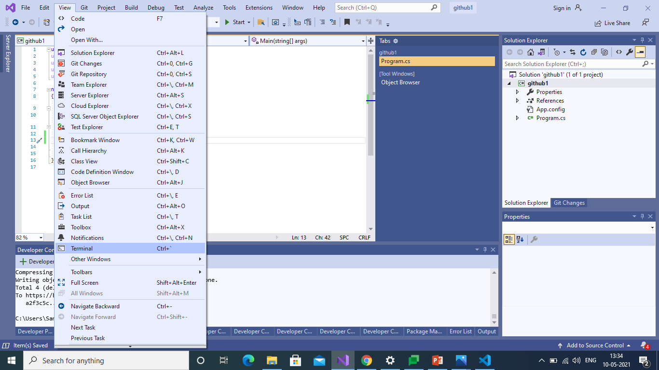
Command Prompt

Slide 23
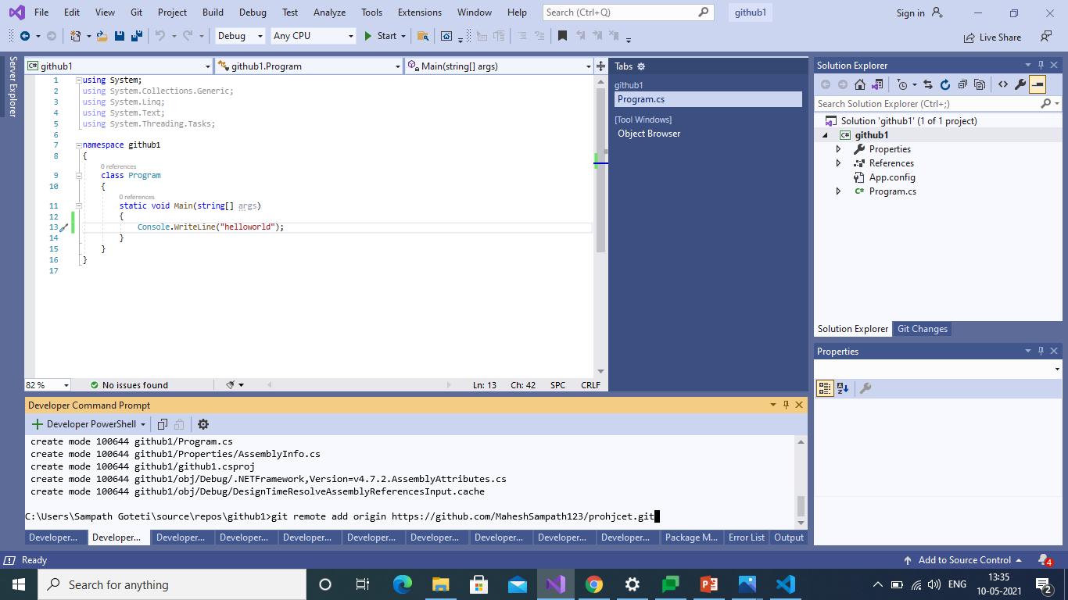
Copied Clone path

Slide 24
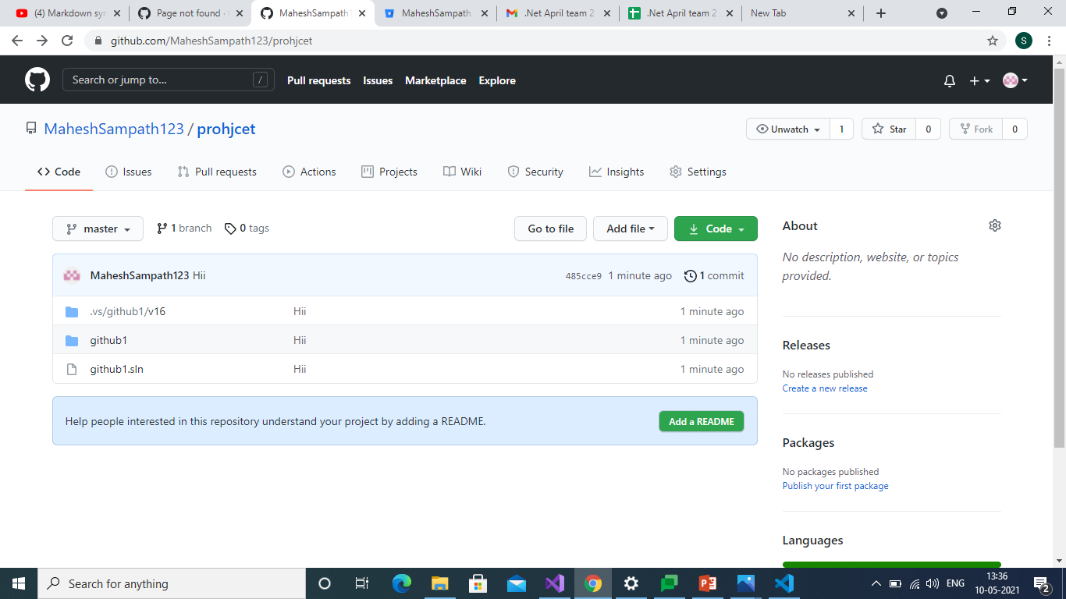
File Stored in Repository

Slide 25
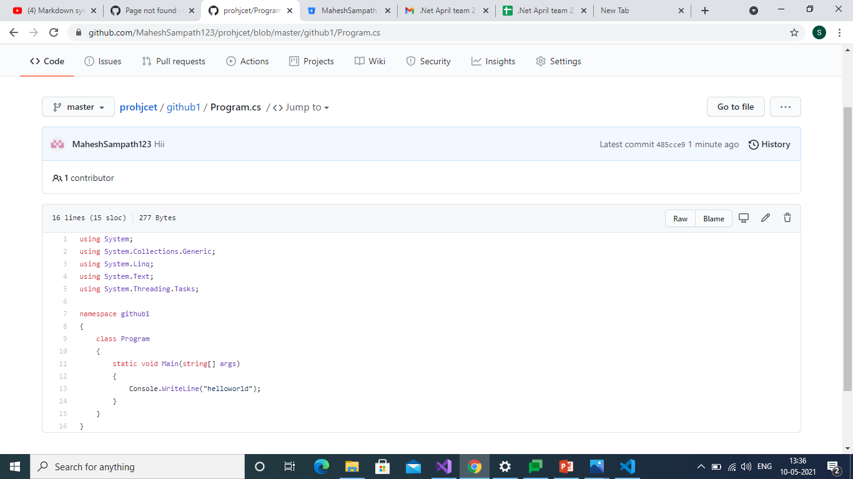
Code is stored

Slide 26
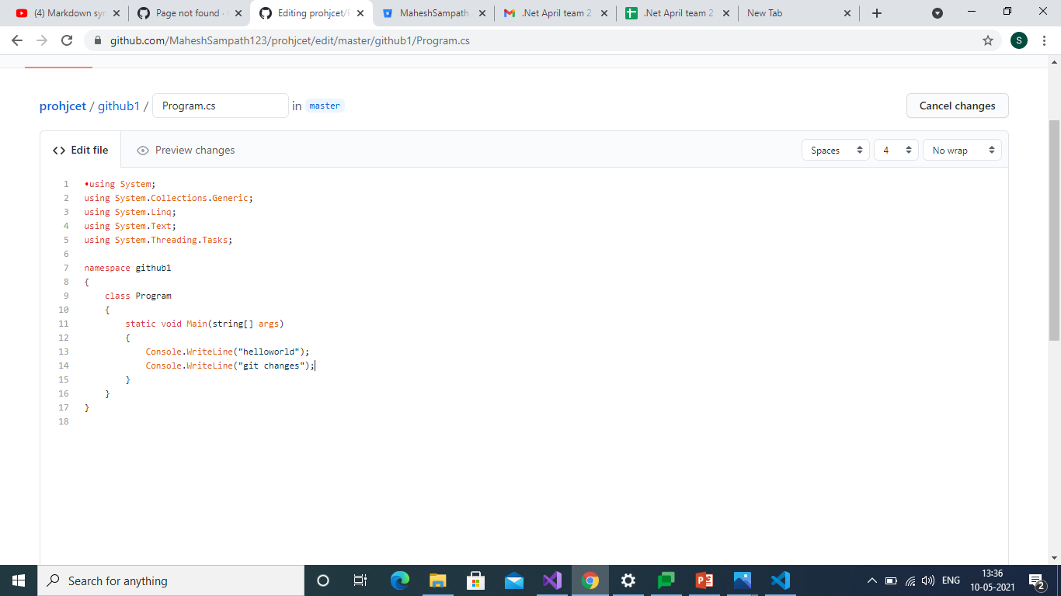
Code Edited and Commited

Slide 27
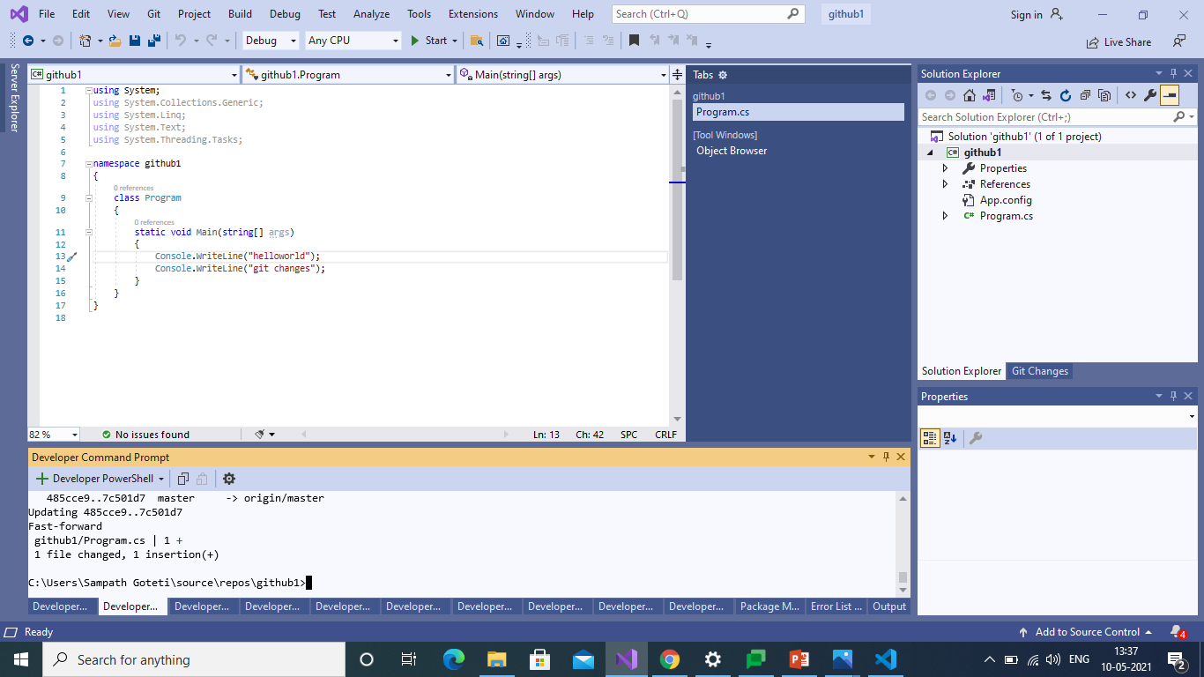
Also changed in Local Repository

Slide 28
GIT Connection For BITBUCKET

Slide 29
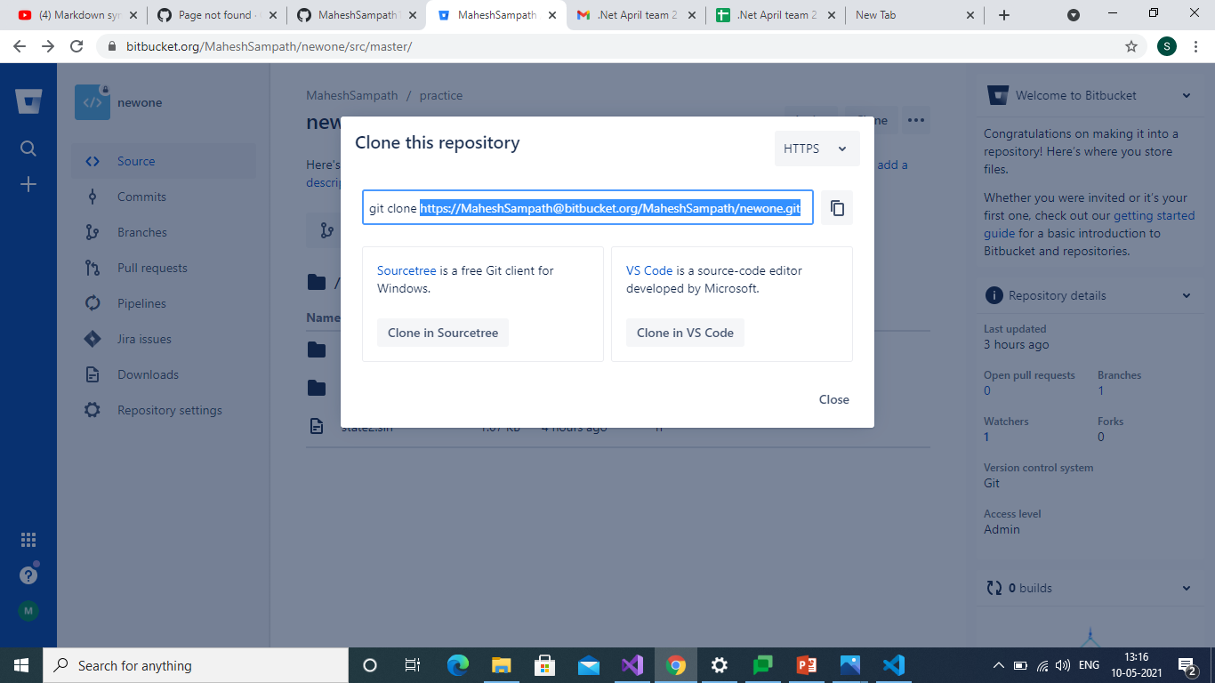
Creating connection using Clone

Slide 30
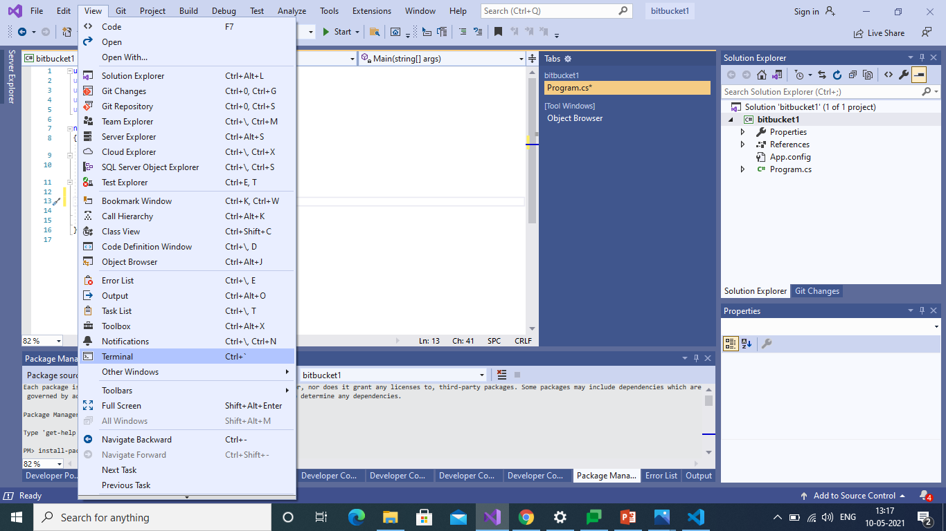
Command Prompt

Slide 31

Copy the Clone in Prompt

Slide 32

Push the File into Repository

Slide 33
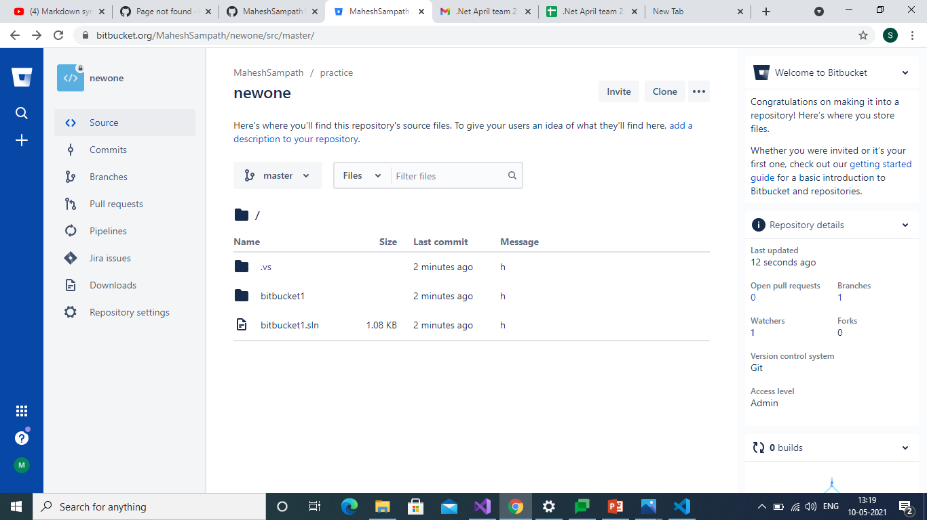
File is Created in BitBucket Repos

Slide 34
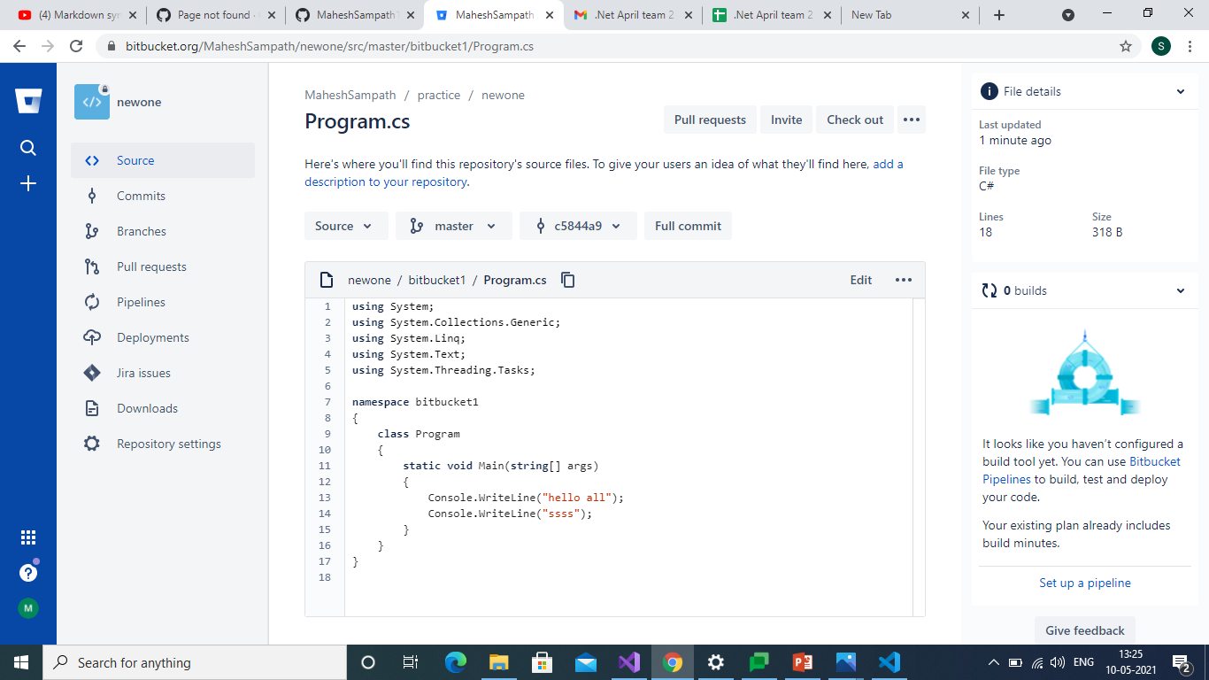
Code is stored in Repository

Slide 35
GIT Connection For TFS

Slide 36
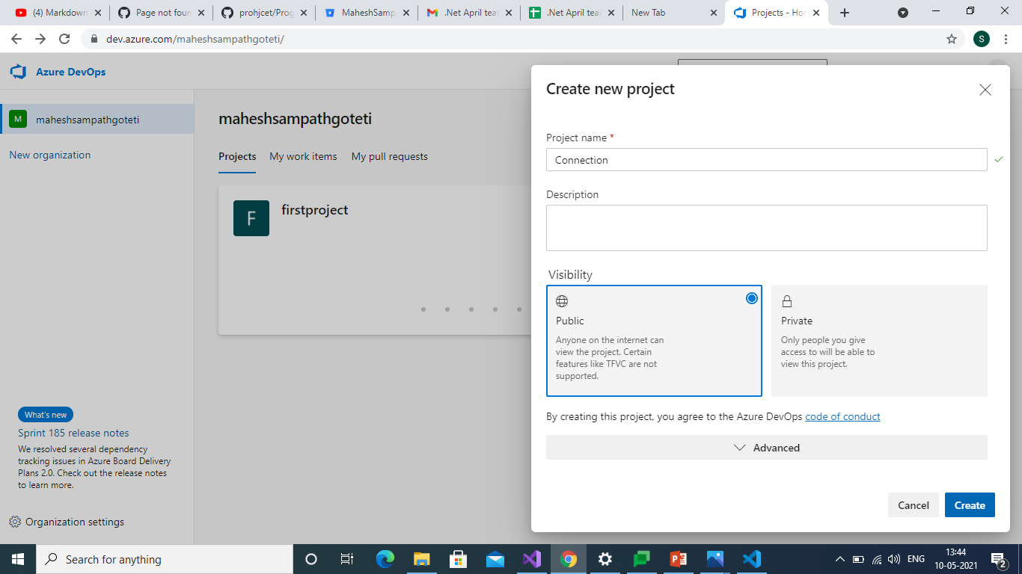
Creating New Project

Slide 37
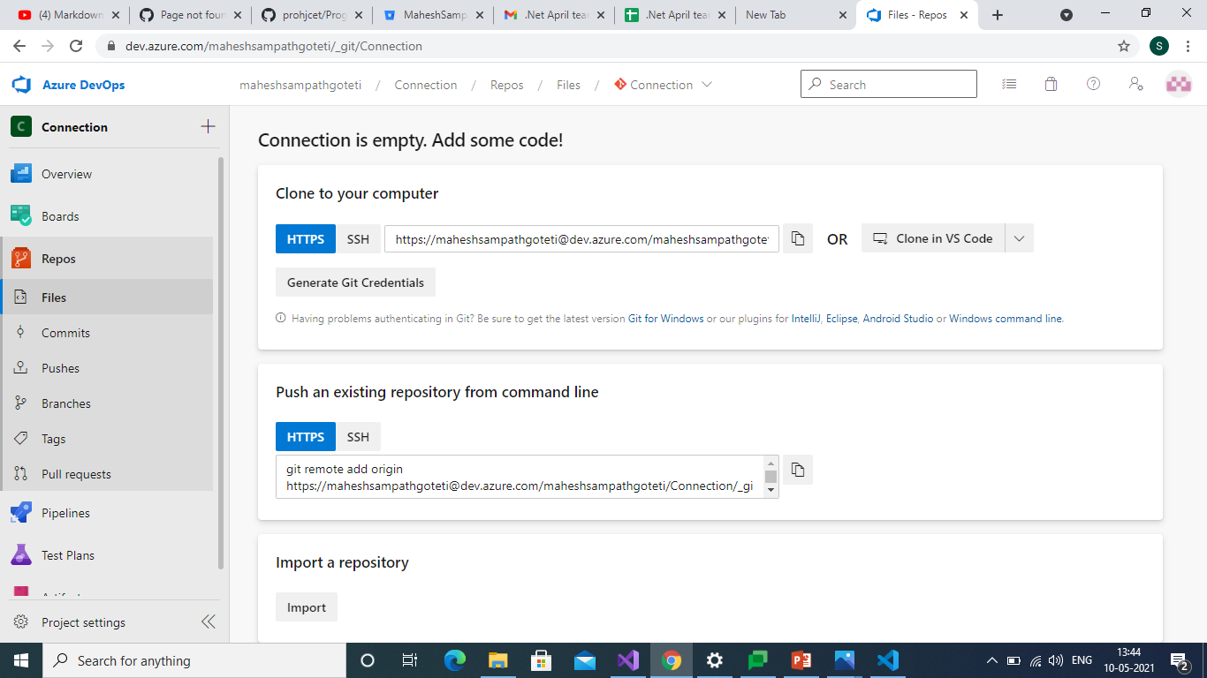
Clone Path to Store

Slide 38

Path Copied in Command Prompt

Slide 39

Pushing the file through Command

Slide 40
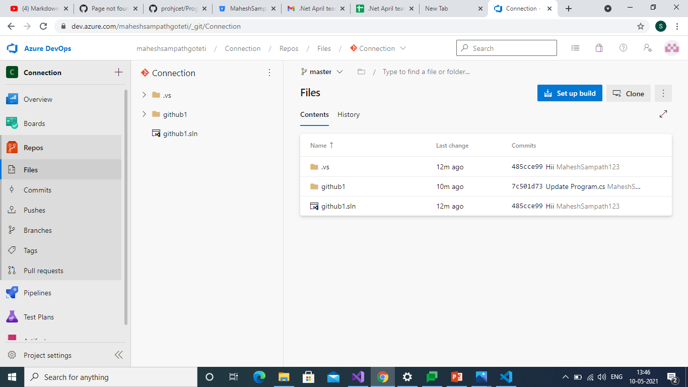
File Stored in Repository

Slide 41
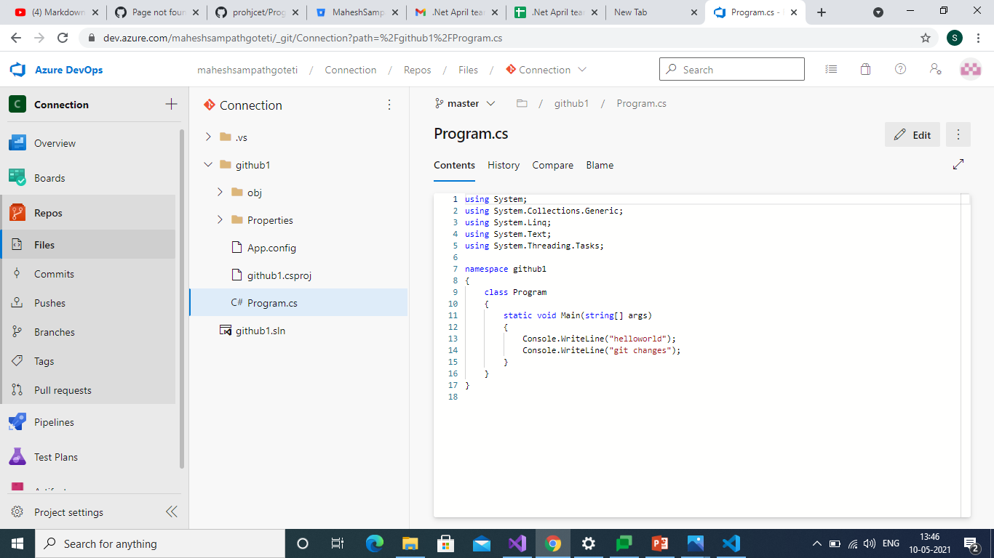
Code is stored in Repository

Slide 42

Code changed from Repository

Slide 43
THANKYOU

